Slide 1
Using an Understanding of Sexual Violence Risk and Protective Factors to Inform Primary Prevention Programming
Washington Coalition of Sexual Assault Programs
Presenter: Erin Casey, Associate Professor - University of Washington, Tacoma: ercasey@uw.edu

Slide 2
Road Map
Context setting and definitions
Risk and protective factors for sexual violence perpetration: What does the research say?
Shared risk and protective factors for perpetration across forms of violence
Prioritizing factors to include in prevention programming
All of you are experts on these topics… please share your wisdom!!

Slide 3
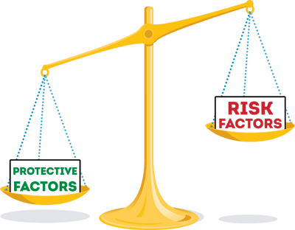
Definitions
Attributes, experiences, beliefs, or characteristics that increase the likelihood of an outcome
Attributes, experiences, beliefs, or characteristics that BUFFER risk factors

Slide 4
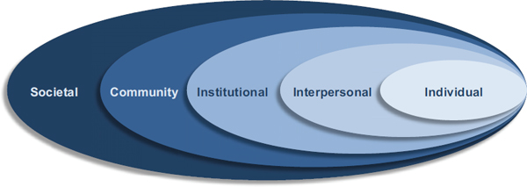
Risk and Protective factors exist at all levels of the Social Ecological Model

Slide 5

Your wisdom needed!
What risk and protective factors most contribute to sexual assault perpetration in the communities YOU serve??

Slide 6
Definitions – conceptualizing prevention
Public Health: Timing of prevention
Institute of Medicine: Target of prevention
Primary
Secondary
Tertiary
Universal
Selected
Indicated
At what levels does your prevention programming operate?

Slide 7
Risk Factors: What does recent research say?

Slide 8
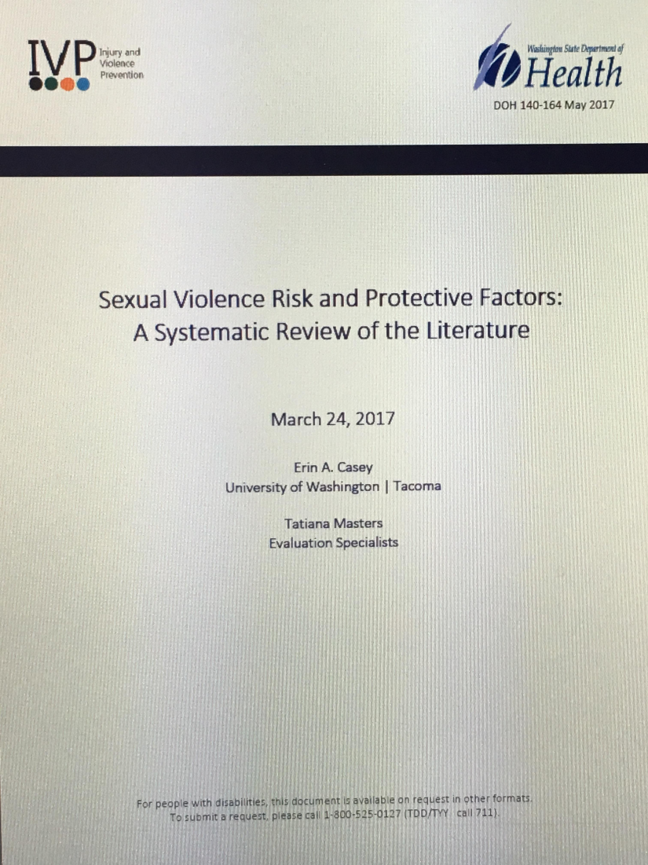
Background and sources
2017 Review of research regarding sexual violence perpetration risk factors sponsored by the Department of Health as one part of a CDC grant to support state-wide prevention evaluation.
Built on a CDC review of adolescent and adult perpetration (Teten-Tharp et al., 2012), and a review of sexual offending against children (Whitaker et al., 2008).
Examines risk factors in research generally, and for LGBTQ, Latinx, and Asian/Asian American/ Pacific Islander communities.

Slide 9
Framing
Research in the U.S. disproportionately represents / includes white participants – we will note culturally / community specific findings as we go.
Research examining macro-structural contributors to violence is hard to do and is somewhat limited (but we will talk about these factors anyway!)
We are primarily focusing on male perpetration of assault against adults and adolescents.
Research has identified almost 40 risk and protective factors. Too many to cover today! We will prioritize those with the most evidence and relevance.
As we briefly review each factor, we will also look at what other forms of aggression (e.g. bullying, IPV) each factor is associated with.
Research is one way of building knowledge, but by no means the only way. Please continue to contribute your knowledge!

Slide 10
Risk Factor #1 – Abuse during childhood
Definition
Physical, sexual, or psychological abuse, or witnessing IPV
Polytrauma creates the greatest risk.
Risk factor for…
Adult and adolescent sexual assault perpetration
Offending against children
Parting thought…
Intervening early, in a trauma-informed way with youth who have experienced abuse may be an important component of selected prevention.
Bullying
Dating violence and adult IPV
Suicide

Slide 11
Risk factor #2 – Rigid gender roles and “hostile masculinity”
Definition
Believing in a dominance-based masculinity, and that men should be in control and command respect.
Coupled with a devaluing of or hostility toward women and girls.
Risk factor for…
Adult and adolescent sexual assault perpetration
Parting thoughts…
One of the strongest, most consistent predictors of sexually aggressive behavior.
Dating violence and IPV
Globally, “gender transformative” primary prevention programs have shown the most promise for reducing sexual assault and IPV perpetration

Slide 12
Risk factor #3: Victim-blaming or violence-excusing attitudes (rape myths)
Definition
Attitudes or beliefs that minimize the impact or existence of sexual assault, that try to justify or excuse sexually aggressive behavior, or try to hold the victim responsible for sexual assault.
Risk factor for…
Adult and adolescent sexual assault perpetration
Parting thoughts…
Rape myths are also racialized – racist stereotypes are built into rape myths in a way that particularly target and impact women of color
Sexual offending against children
Bullying
Dating violence and IPV
Men who persist in sexual aggression have been shown to adhere to rape myths more strongly than men who desist (Thompson et al., 2015).

Slide 13
Risk factor #4 – “Impersonal sex”
Definition
Casual, non-intimacy based approach to sex in which “scoring” may be more important than intimacy.
Risk factor for…
Adult and adolescent sexual assault perpetration
Parting thoughts…
Many people have active sex lives with casual partners without being sexually aggressive or coercive. This risk factors is most problematic when paired with hostile masculinity (e.g. Confluence Model – Malamuth et al., 1995).
Dating violence
Clusters with sexual risk taking behaviors such as high numbers of partners, and feeling pressure to be sexually active.
Slightly similar (but different) sex-related risk factors for child sexual abusers include preoccupation with sex and deviant sexual arousal patterns.

Slide 14
Risk factor #5: Perceived peer approval
Definition
Believing that friends and male social network members approve of coercion or force to gain sexual access.
Risk factor for…
Adult and adolescent sexual assault perpetration
Parting thoughts…
One of the strongest, most consistent predictors of sexually aggressive behavior.
Dating violence and IPV
Research also shows that men are not accurate in assessing their peer’s beliefs and attitudes.
Believing that male friends engage in sexually aggressive behavior.

Slide 15
Risk factor #6: “Minority stress”
Definition
Minority stress: the impact of discrimination, negative stereotypes, marginalization, and micro/ macroaggressions
Risk factor for…
Adult and adolescent sexual assault VICTIMIZATION (not perpetration).
Parting thought…
In contrast, maintaining a strong cultural / ethnic identity and close ties with a community serve as protective factors against victimization.

Slide 16
Protective factor #1: Social support and social connectedness
Definition
Input from friends, family, and others that helps individuals believe that they are valued, loved, and part of a reciprocal network of care, assistance, and responsibility.
Protective factor for…
Adult and adolescent sexual assault perpetration
Parting thought…
Although important for everyone, social support is particularly crucial for LGBTQ youth, and has been shown to significantly reduce vulnerability to victimization.
Sexual offending against children
Bullying
Dating violence and IPV
Suicide

Slide 17
Protective factor #2: Empathy
Definition
Ability to understand and share another person’s emotional experience or perspective. The ability to understand and notice one’s impact on others.
Protective factor for…
Adult and adolescent sexual assault perpetration
Parting thought…
Early childhood social emotional learning programs may be an important strategy both for fostering this protective factor and for buffering the impacts of childhood trauma.
Sexual offending against children
Bullying
Dating violence

Slide 18
…. And many more (Teten-Tharp et al., 2012).
Sorry for the blurriness… you get the idea!

Slide 19

Applying risk/protective factors
How have you (or might you) decide which risk factors to prioritize in your on-going primary prevention programming?

Slide 20
Prioritizing risk and protective factors… criteria to consider
Prioritize young people most at risk (selected prevention)
Prioritize factors most relevant to your community context
Prioritize most “potent” risk factors (gender-related attitudes, perceived social norms, etc.)
Prioritize “shared” risk factors that contribute to multiple forms of aggressive behavior

Slide 21
THANK YOU!!
And – thank you to WCSAP and the Department of Health!
Erin: ercasey@uw.edu

